Slide 1
Unit 1: Concepts of Motion
Section 1.6
Motion in One Dimension

Slide 2
Determining Sign
Remember that position, velocity, and acceleration are vectors and thus have direction
We can use (+) or (-) to help describe direction
Imagine imposing a coordinate plane over motion
Use zero as the origin
The x axis is positive to the right and negative to the left of the origin
The y axis is positive above and negative below the origin

Slide 3
Position
The sign of position (x or y) tells us where an object is

Slide 4
Velocity
The sign of velocity tells use which direction the object is moving

Slide 5
Acceleration
The sign of acceleration tells use which way the acceleration vector points, not whether the object is speeding up or slowing down.

Slide 6
Acceleration can be a little tricky…
Acceleration + or -?
Speeding up or slowing down?

Slide 7
The SIGN of the acceleration DOES NOT indicate if object is speeding up or slowing down!
Acceleration and Velocity same direction = SPEEDING UP
Acceleration and velocity opposite directions = SLOWING DOWN.
ZERO Acceleration = Constant Velocity

Slide 9
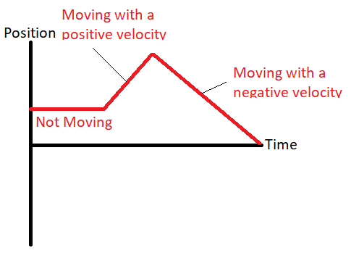
Position-versus-Time Graph
This type of graph always has the position plotted on the y axis and time on the x axis.
This way the slope is equal to the velocity

Slide 10
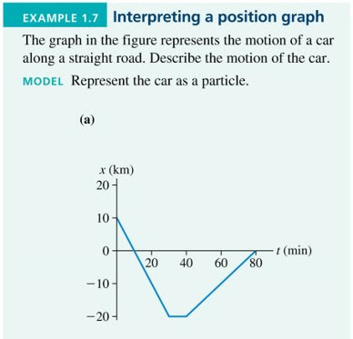
Let’s figure out what is happening here…

Slide 11
Assignment
Page 30, numbers 19-20

